Slide 1
Purview UI after the Scan

Slide 2
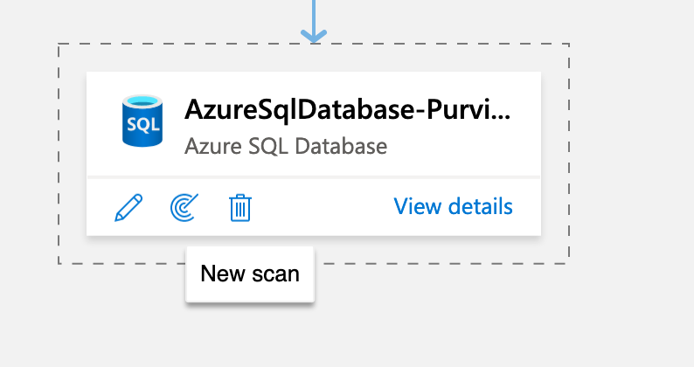
Data Source Crawling
Central location to register data sources. During registration, data remains in its existing location, but a copy of metadata is added to azure purview along with data source location.
Support for hybrid data platforms
Metadata is indexed, to make each data source easily discoverable via search and understandable to users who discover it.
Once the source has been registered in Azure Purview, we can initiate the scan for the added sources.
Once the scan has been started, it will crawl the data from the registered source and extracts metadata from it.
Based on the metadata, it classifies the data and build data lineage from the metadata.

Slide 3
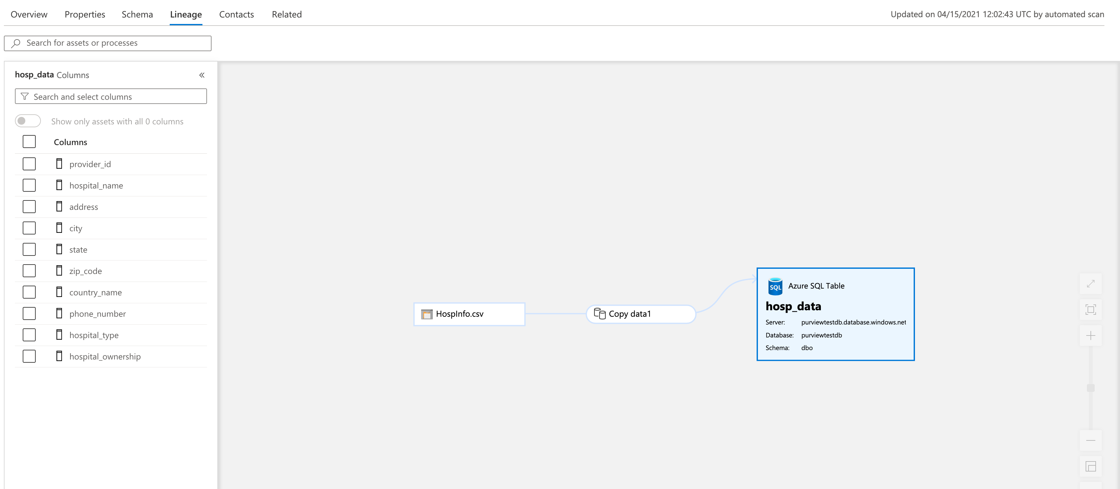
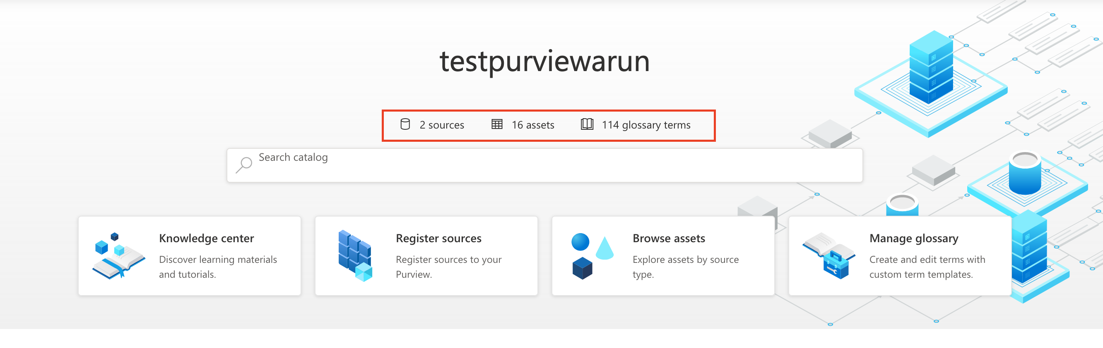
Metadata and Data Lineage
Purview has a mechanism with which one can bind it to services like Azure Data Factory from which it can automatically extract lineage
Azure Purview scans the data from the source and captures the metadata and list it on its Purview home page.
Azure Purview captures the data lineage from the captured metadata, and it displays the graph.
Data Lineage graph is getting displayed only when Azure Data Factory involved.

Slide 4
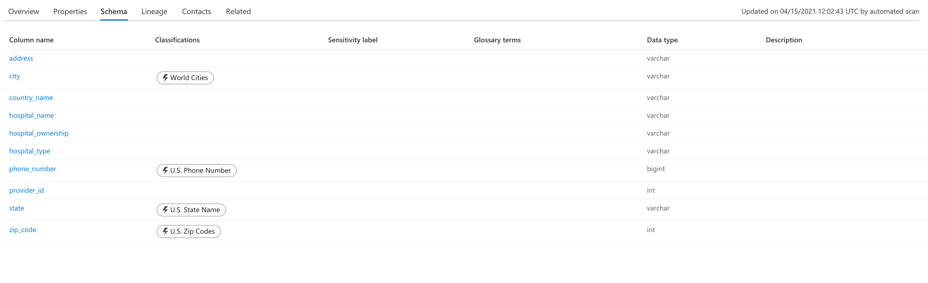
Data Discovery and Classification
Azure Purview offers a mechanism to scan data repositories and detect metadata with more than 100 classification rules that automatically classify the attributes based on the matching rules
Azure Purview classifies data using regex and bloom filter.
It classifies Government, Security, Personal and Miscellaneous data.
Supported classification:
https://docs.microsoft.com/en-us/azure/purview/supported-classifications

